Slide 1


Slide 2
Concept
Description:
This application will help you, your friends, and/or family create a Secret Santa system to randomly pass gifts to each other for any holiday
Motivation for development:
Since the holiday season is coming up, we were excited to help anyone who wants to keep track of their Secret Santa or gift exchange events, such as for Christmas parties, Hanukkah, etc.
User story:
IF I have friends
THEN I want to invite them to a Christmas party
IF they accept my invitation
THEN they will be able to join the event
WHEN they join the event
THEN they will be entered into the Secret Santa lottery
WHEN they are matched with a recipient
THEN they will be able to view their recipient’s wish list and links to wish list items to choose from for the gift exchange

Slide 3
Process
Technologies used:
JavaScript
CSS
NodeJS
Mysql2
Sequelize
Bcrypt
Dotenv
Express
Express-handlebars
Express-session
Connect-session-sequelize
Nodemailer
MomentJS
Nodemon
Bootstrap v5
Animate.JS
LottieFiles
Breakdown of tasks and roles
Challenges
Successes
Breakdown of tasks and roles
Back-end:
Sivan and Antonio
Front-end:
Jose and Gokul
Challenges:
Multiple async steps in one route (multiple then’s)
Color scheme
Successes
Initial design layout
Seeds
Designing models first
No major conflicts in GitHub
End result

Slide 4
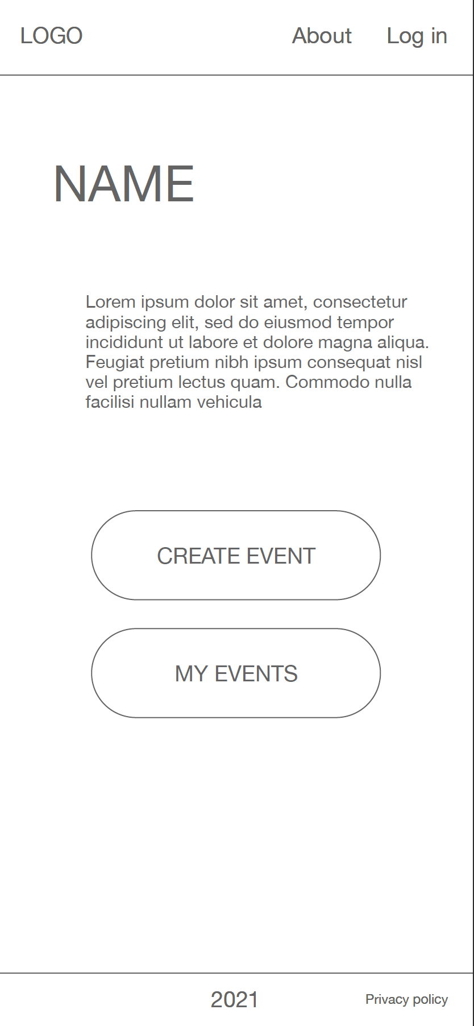
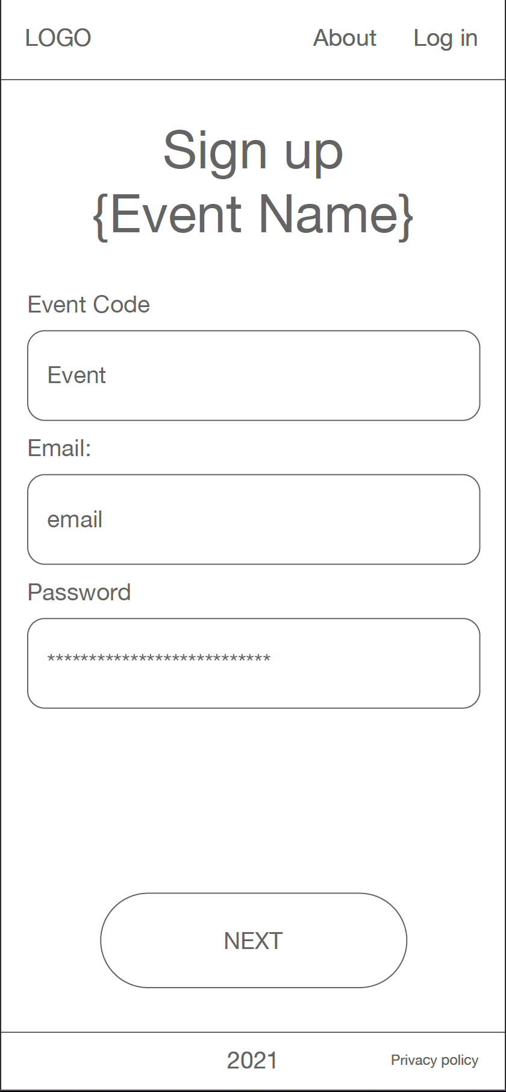
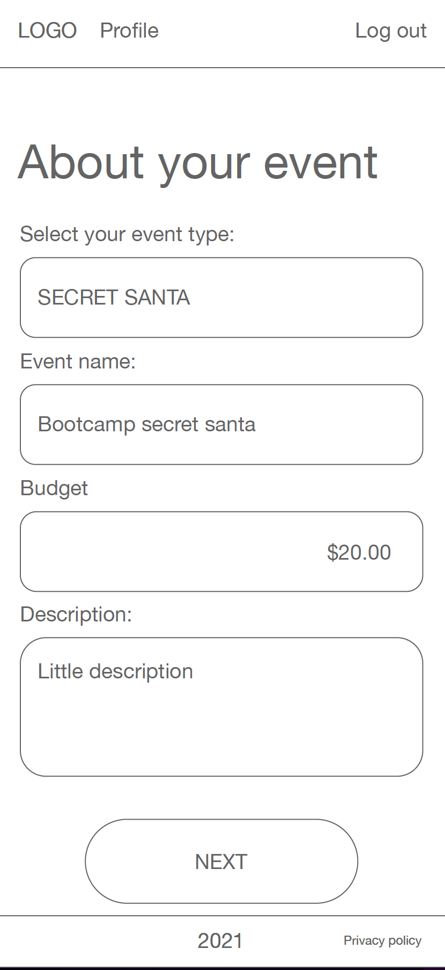
Demo
Initial Design
https://secret-santa-project.herokuapp.com/

Slide 5
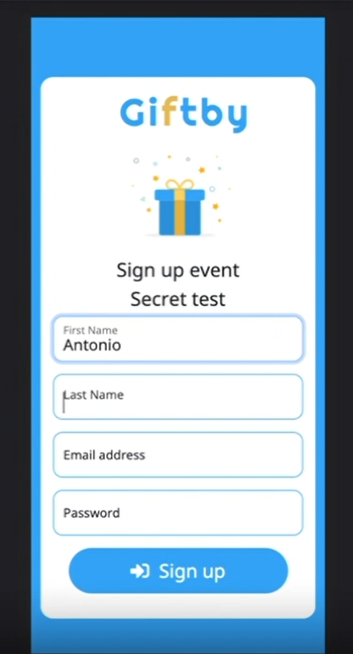
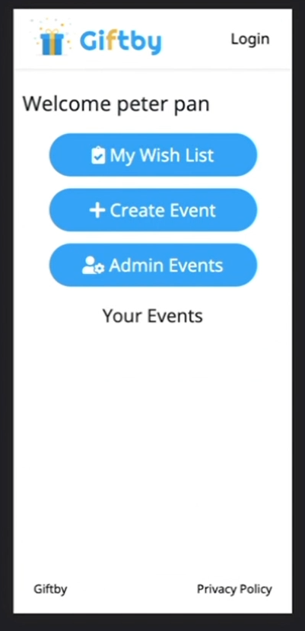
Current Design

Slide 6
Directions for Future Development
Link to share instead of email
Better email design with links to add to calendar and more
Comments on events and wishlist items
Event rules/restrictions
QR code for invitations
Password retrieval
Mobile app (IOS/Android)
Affiliate for wishlist items

Slide 7
Links
Deployed: https://secret-santa-project.herokuapp.com/
GitHub repo: https://github.com/Tonycodesnow/theNextGen

